Slide 1
UX/UI for Games
I’ve been working on 4 titles released by Crazypanda Games:
Stellar Age (live)
Hardcore mobile global MMO strategy game
The Household (live) Classic farm game with content updates.
World Pocker Club (live) The most popular social poker in Russia and the CIS
Bottle. Find your Love(closed) Classic bottle-dating game with kisses. Based on hyper-popular Russian reality show franchise: “Dom 2”

Slide 2
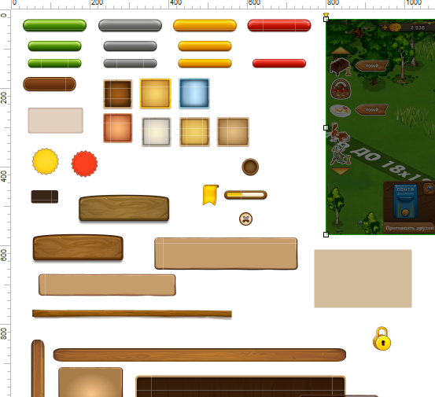
The Household
Overview: I have successfully designed UX & UI of 20+ new game mechanics modules.
Workflow:
Functional requirements doc.
“Box” prototype to organize userflows and break information into layers.
UI prototype to organize information weights (tone/color accents)
Special art preparation (backgrounds, decorative elements)
Implementation
https://apps.facebook.com/playhousehold

Slide 3
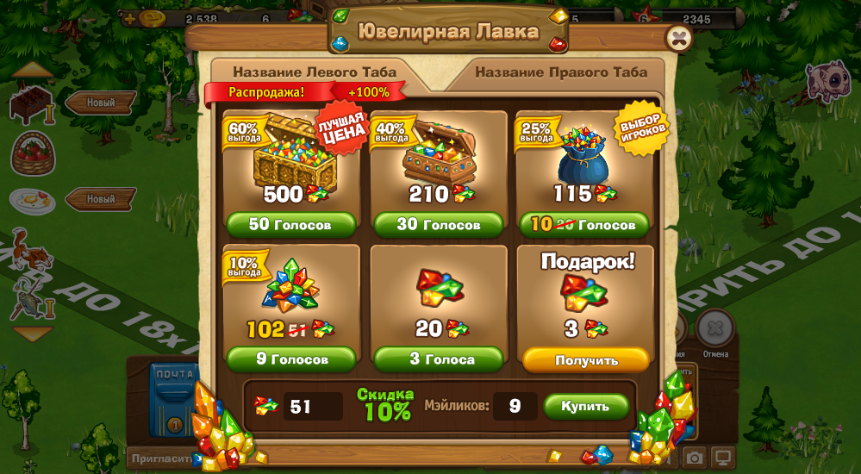
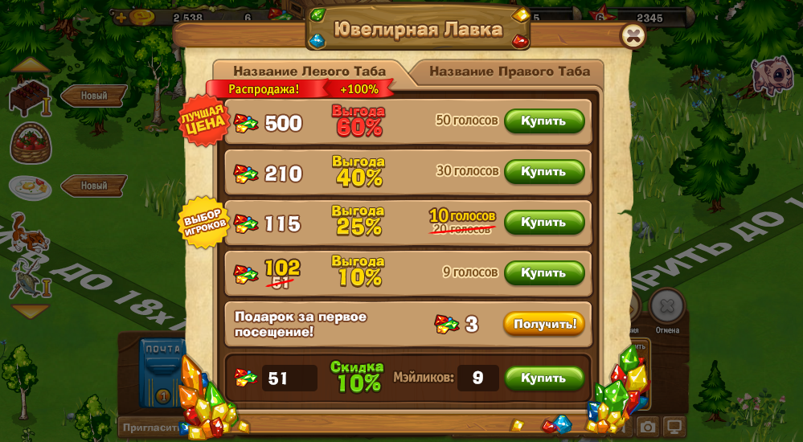
The Household
Task: Refresh “Bank” window design. Improve accent on discounts.
Solution:
Make two variants of layout (“6-pack” & “ladder”) and test both on new-comers vs high-level players.
Add additional discount marker for top-profit SKU
Result: “6-pack” design performed better for new-comers, but “ladder” was loved by the core audience. Both designs performed better than the old one.

Slide 4
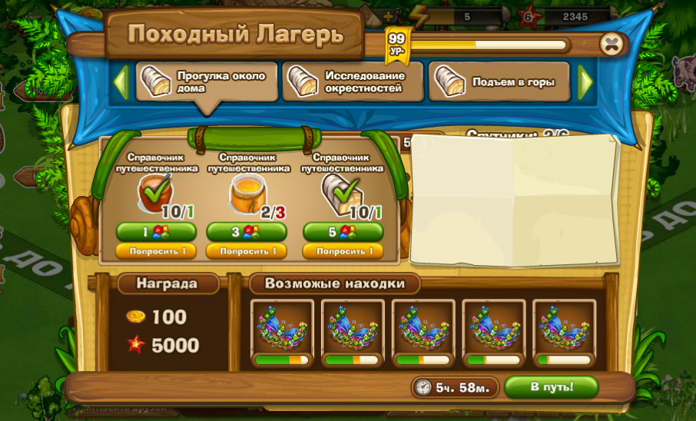
The Household
Task: Design “Hiking Camp” mechanics. User buys a landmark. Each landmark represents destination of journey. The output is:
Gold & Exp. (100% chance)
Prem. item (<100% chance)
Users can ask friends to join their journey. Each friend increases chances of finding premium items.
Solution:
Progress bar with 2-colored threshold to show chance w/wo friends.

Slide 5
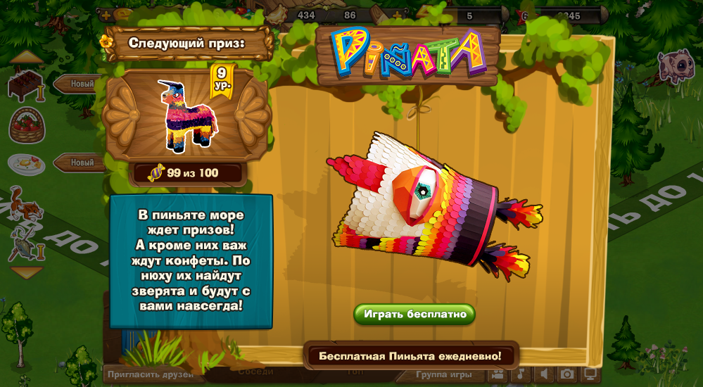
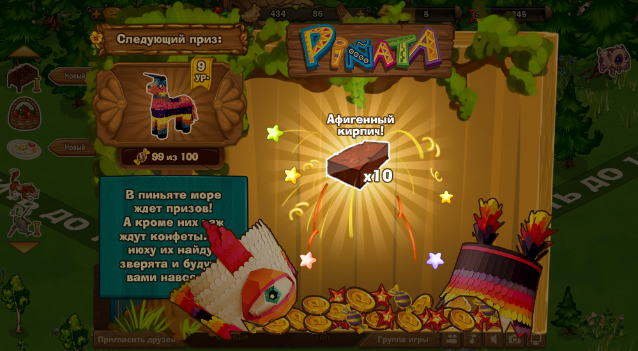
The Household
Task: Create gambling mechanics with single prize per roll. Each player has own prize pool.
Solution:
“Piñata” idea.
Peñate

Slide 6
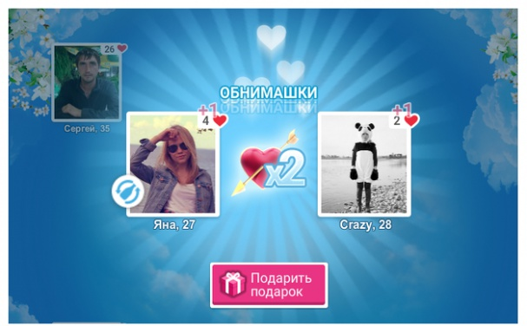
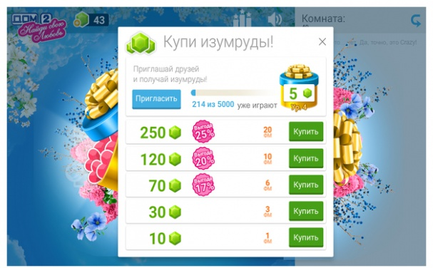
Bottle: Find Your Love
Overview: Our company had an opportunity to ride on a wave of hype from the reality show Dom 2. We had only 4 weeks to create a social game for tens of millions of fans all across Russia and CIS. National TV promised us TV show integration and promo.
I was very happy to become a part of such outstanding and small team of 5 people who managed to develop and ship a multiplayer game in such a short period of time.
I was in charge of the overall UX of this social game and developed all UI assets.

Slide 7
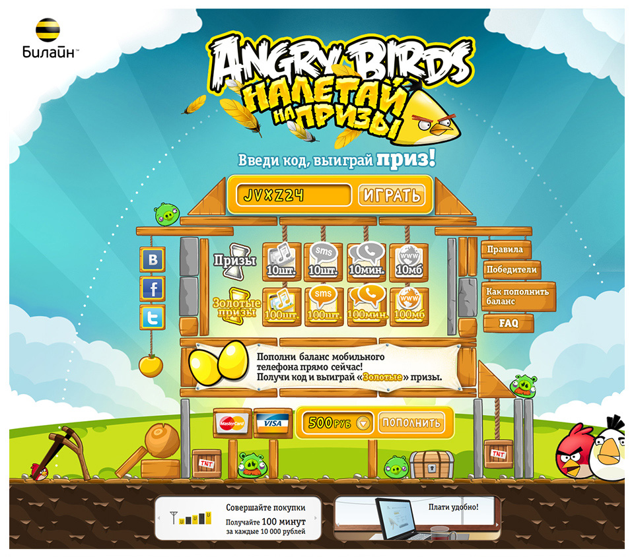
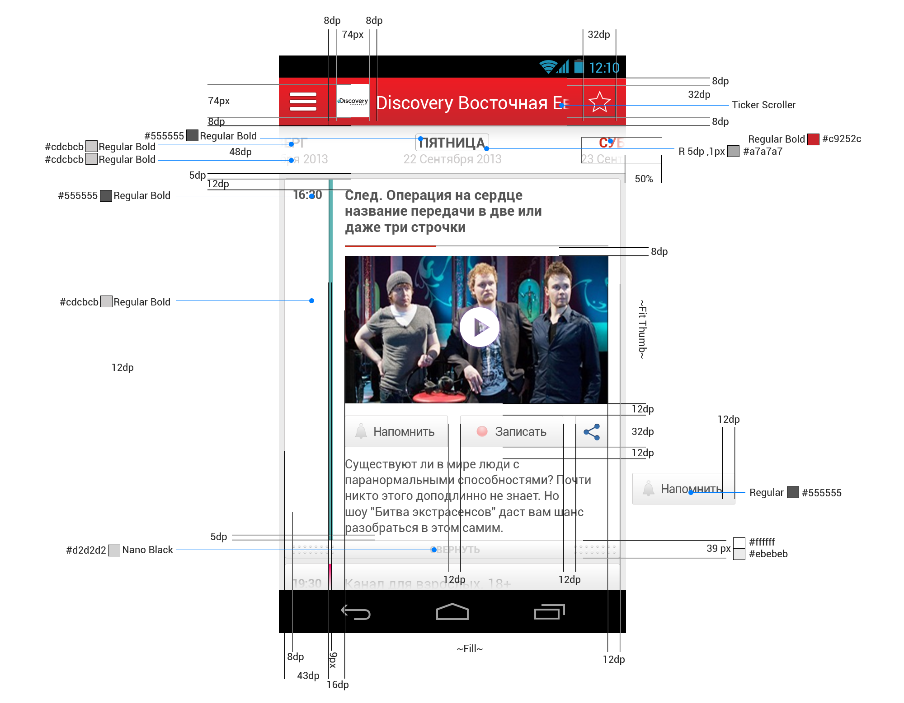
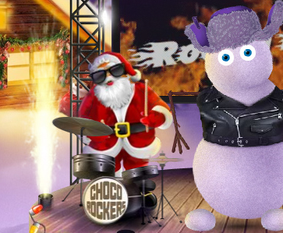
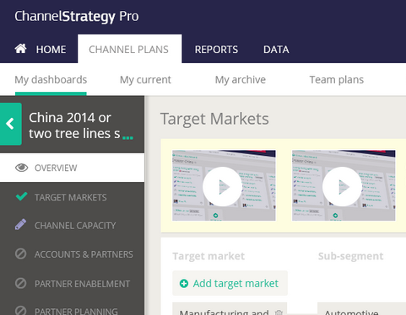
UX for Business
I’ve completed over 40 interactive promo projects for world-wide brands as a Digital Art Director and later as a Digital Creative Director.
My favorite brands, I worked with:
IBM
Kraft Foods
Milka
AlpenGold
British American Tobacco
Beeline (Russian telecom #1)
Procter & Gamble
Always
CTI (Interactive TV, mobile+ set-top box)

Slide 8
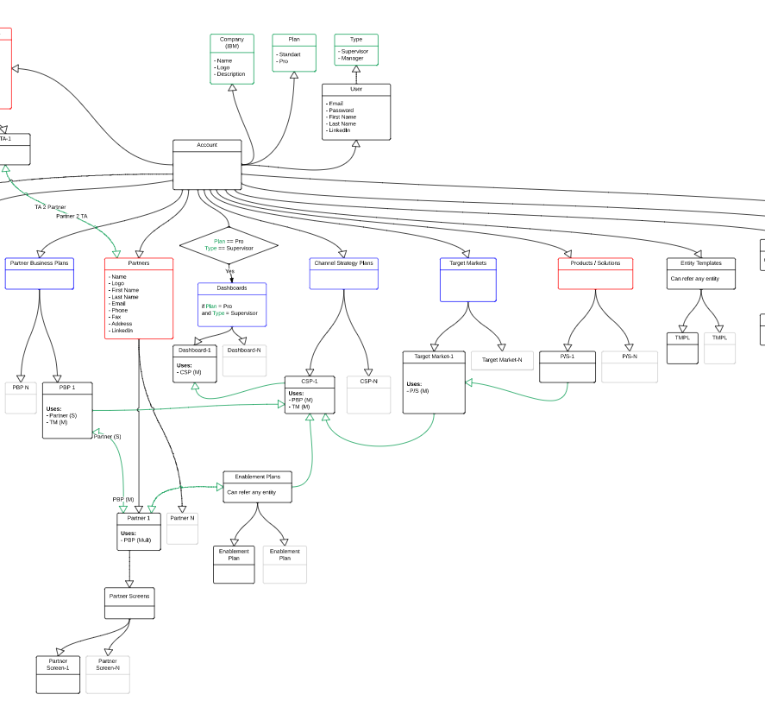
Channel Strategy Pro
Product: Online cloud tool to ease the regional sales process. For a company like IBM that has no interest in direct sales, but channel sales/vendor contracts, this tool became #1 weapon of regional sales man.
Before it was done by filling in huge 50-paged Excel file.
What I have done:
Separated Excel-fill-in flow into several use cases based on user roles: Channel Manager/Director
Redone data relationship scheme
Applied use-cases to data relationship scheme.
Prototype
Design.

Slide 9
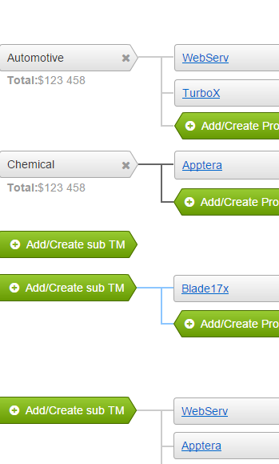
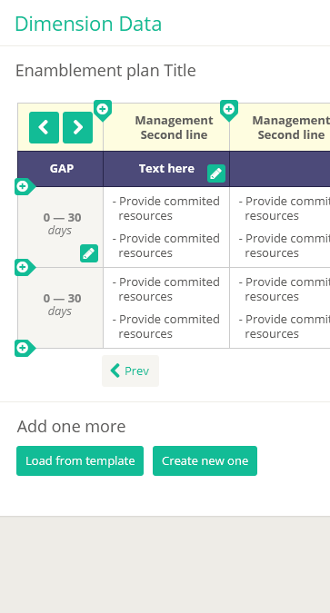
Channel Strategy Pro
Fist iteration prototype: http://yg1osz.axshare.com/#p=home
UI Design: http://qtgas3.axshare.com/#p=home
Data Scheme https://www.dropbox.com/s/w3wkgywghs0r79g/CSPro%20-%20DB%20v6.pdf?dl=0

Slide 10
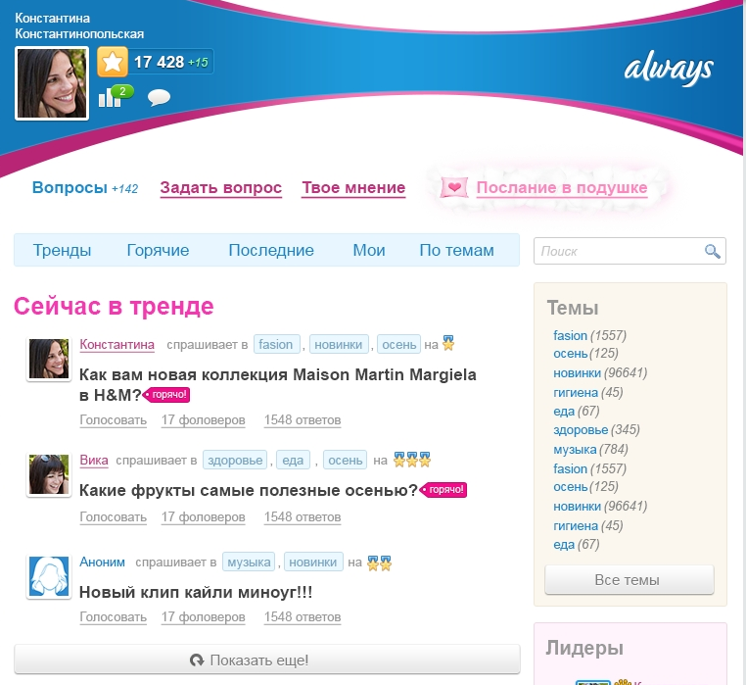
Always Social Hub
Product: Online hub for women inside a top Russian social network OK.ru
Features:
Social Q&A with ratings
Product information
Promo sections
Prototype:
http://artfabrique.github.io/cv/portfolio/Always/Hub/start.html
Source:
https://dl.dropbox.com/s/5ztaurcq49yxkf5/alwaysSocialPlatform.rp

Slide 11
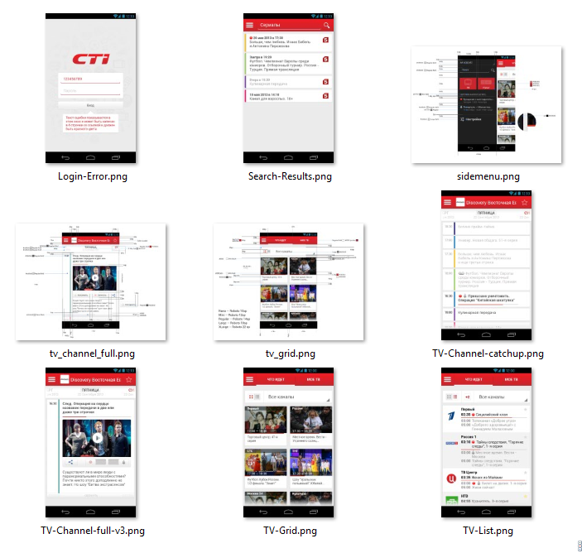
CTI
Product: Interactive TV connected to the mobile app. (multiscreen app)
Features:
TV schedule
Interactive TV context on mobile companion app.
Reminders and remote record of any show.
Live streaming to mobile.
I’ve developed:
User Flows based on time of the day, gender & method of transportation.
UI Design.

Slide 12
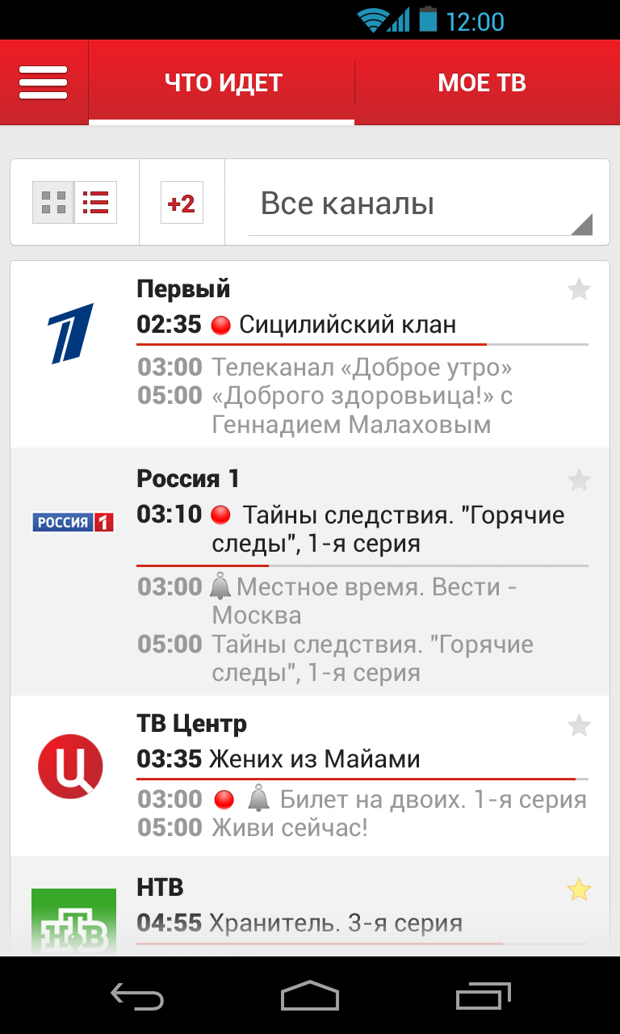
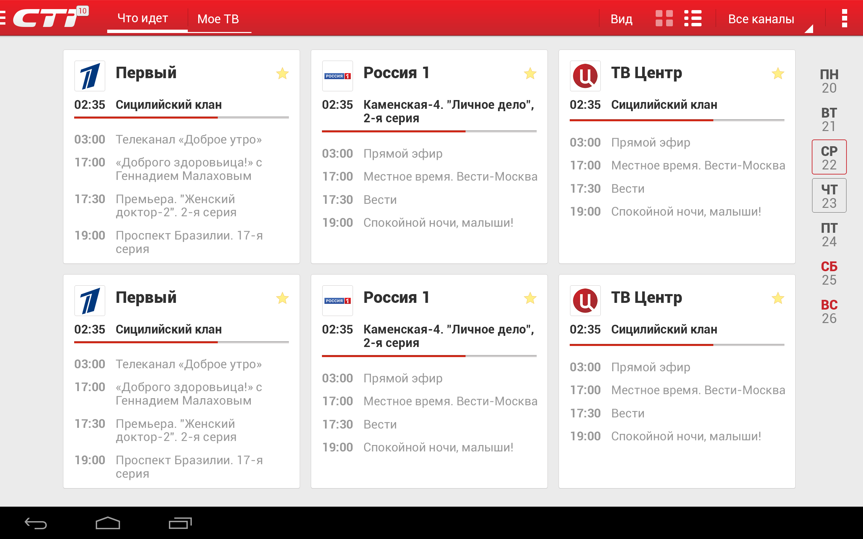
CTI

Slide 13
Beeline
Product: Top-up promo with Angry Birds
Overview:
User makes top-up
User receives 1-10 lives in a special branded level of AB
User launches a birds trying to hit the prizes
Free minutes packs
Free data packs
Free sms packs

Slide 14
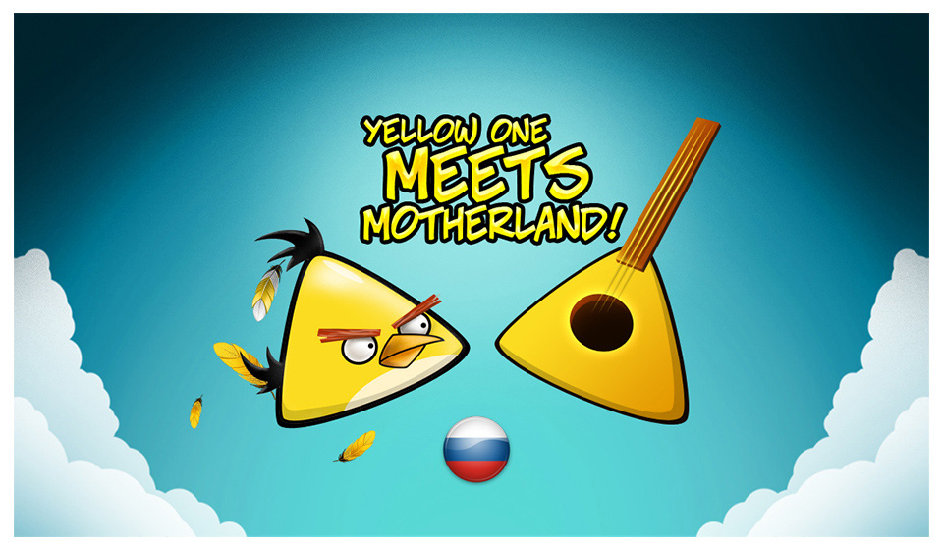
Beeline
I’ve proposed an idea about yellow Bird who is triangular because he grew up in Balalaika (national music instrument). Now his brother is in danger and all the birds company arrives Russia to save him.

Slide 15
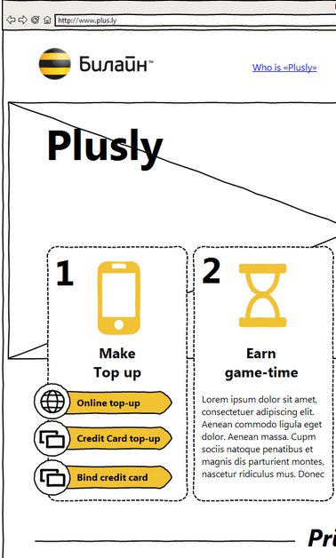
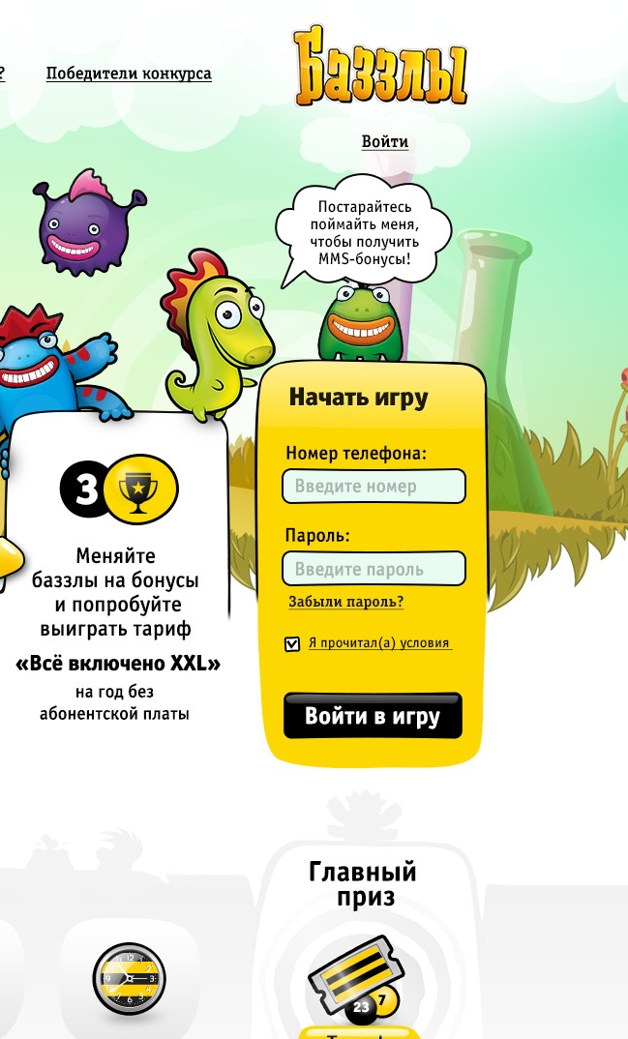
Beeline
Project: Plusly. Top-up motivation platform with gamification.
http://artfabrique.github.io/cv/portfolio/Beeline/Beeline_proto_v2.html
Overview:
User makes top-up
User receives token for 5-10 seconds of gameplay
User plays a game and tryes to catch all bonuses
When time runs out user gets all the rewards that he scored.
Free minutes packs
Free data packs
Free sms packs

Slide 16
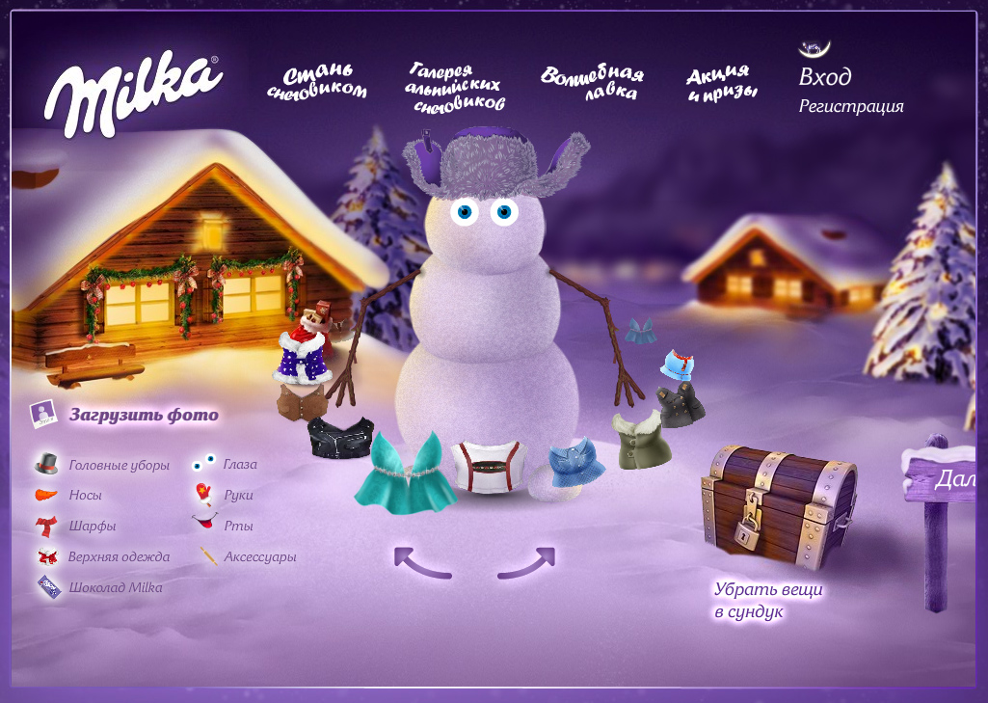
Milka
Product: Promo website with UGC.
http://www.youtube.com/watch?v=-uza8kPGwjI
Features:
Create a snowman
Dress him up
Share with friends & download desktop snowball widget
I’ve developed:
All design & illustrations
All client-side code (AS3)
This project and idea of virtual Alpine Village became a platform for brand communication for 3 years.
In 2009 Ogilvy & Mather grabbed gold award at EFFIE in “Digital” nomination.

